Slide 1

Notes:
The Microsoft Azure for Research program helps researchers explore and experiment with Azure at scale.
We provide awards, training and technical resources to help you make the most of the cloud.
See azure4research.com
> 75 projects in Brazil
> 100 projects in Europe

Slide 2
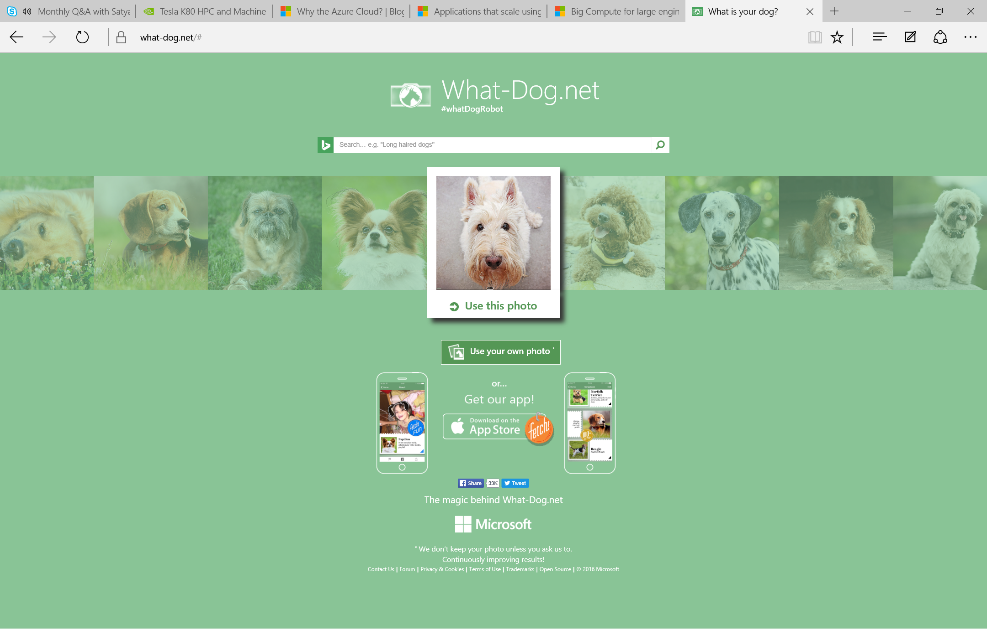

Slide 3
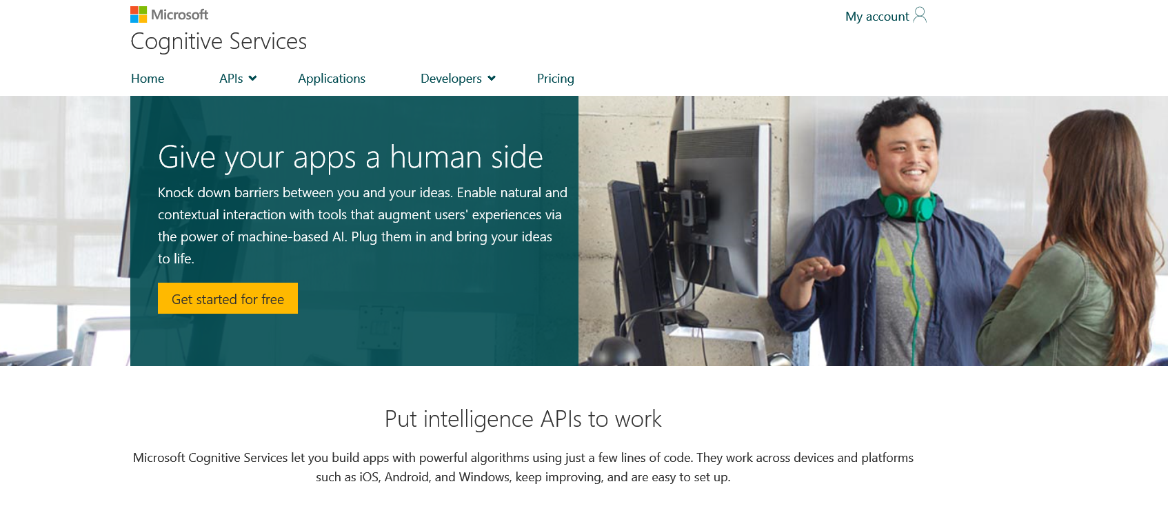
https://www.microsoft.com/cognitive-services/en-us/apis

Slide 4
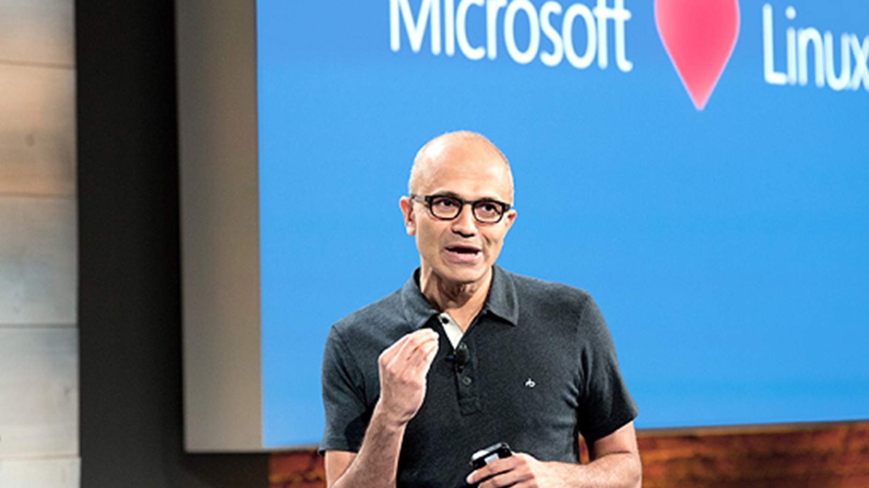
Research Scenarios
Beyond the desktop
High Performance Computing (“Big Compute”)
Data Science (includes “Big Data” & “Machine Learning”)
Internet of Things
Research Collaboration
Research Data Management

Slide 5
“The best thing about having your own cluster though, is of course no wait times in queues! You are of course also admin on your cluster …. I could organize my workflow and environment in a way that was right for me. Azure for me was perfect. I could scale my compute capability with my current computational needs.”
Dr Simon O’Hanlon , Researcher, Imperial College London

Slide 6
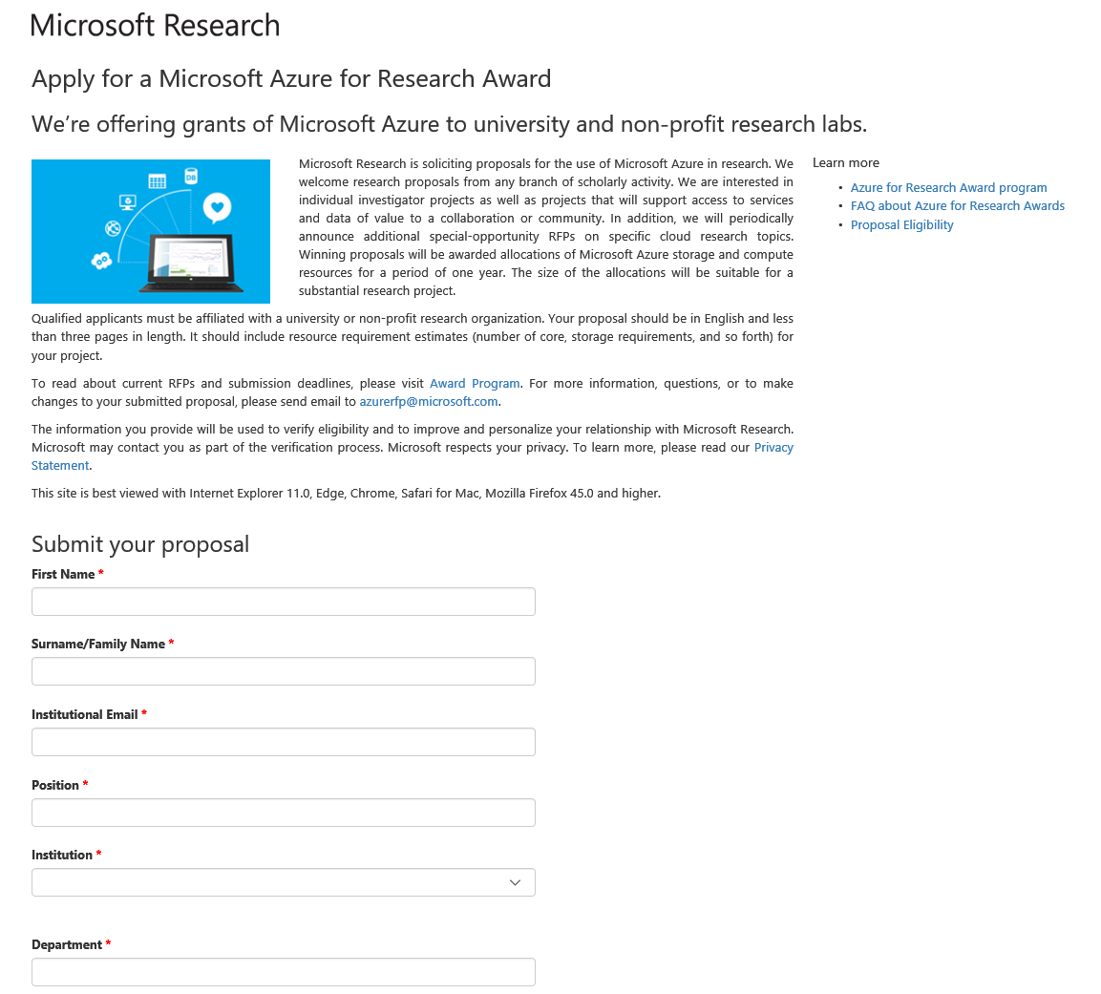


Azure for Research
Cloud computing awards
250,000 compute hours
20TB storage
Big data, machine learning, IoT, and more….
Deadline: 15 ??? 2016
(and every two months)
Email: azurerfp@microsoft.com
www.azure4research.com
Microsoft Azure for Research Group
@azure4research
Notes:
Please apply for one of our 12 month awards, which give you substantial Azure resources for your project.
CALL TO ACTION:
Apply for an award at azure4research.com (you can also email us at azurerfp@microsoft.com)
Next deadline is 15 December, and every two months (15 Feb, 15 April, etc)
Join our LinkedIn group and join the conversation on Twitter.
PROPOSAL GUIDELINES for Q&A
We are particularly interested in researchers wanting to tackle data science, big compute, internet of things, and Azure Machine Learning
Proposals are very short: 3 pages, 1000 words
Format is:
Project summary (100 words). We are specifically looking for opportunities where researchers are making use of higher-level Azure services (i.e. Not just virtual machines and storage). You can see what is available at https://azure.microsoft.com/en-us/services/
Impact. Will this award be of significant benefit to a community of users, either within a discipline or organisation. Will it push science forwards? It cannot be just benchmarking or a single scientific paper, but a scientific service that researchers are asking for is ideal. It should be a single project/theme, not a whole group’s activities. List collaborators who you will work with, and/or use your service. How will it be dissemintaed, beyond academic publications, e.g. open-source solution
Feasibility. Is the project appropriate for Microsoft Azure? Is it a sensible fit for the Cloud, and is it technically sound? Do you have people, with the right experience and time, in place to develop and deploy your application on Azure?
Resources. Does the applicant have enough resources (people/effort) to complete the project successfully. The award is only for Azure resources (compute, storage, bandwidth, etc), not for people. Around $20,000 USD in Azure resources over 12 months. Applicants need to describe proposed usage. e.g. ???? compute hours in 12 months, peak 32 cores. ??? TB per month data. We can help with this.
Note these awards are only for Azure time, not other costs.

Slide 7
Discussion Q&A

Slide 8
Microsoft Azure for Research
Key learning objectives for this class
A solid understanding of cloud computing
Why and when you would use it in scientific or other research
Hands-on experience with features that are relevant to research
Skills to run your own applications/services on Azure
Ultimately: Allow researchers to feel confident using cloud computing in their current and future research

Slide 9
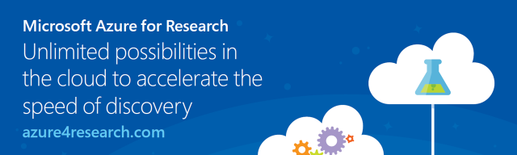
Thank you for coming and safe travels!
Submit proposals @ www.azure4research.com
Email us: azurerfp@microsoft.com
Microsoft Azure for Research Group
@azure4research

